Slide 1
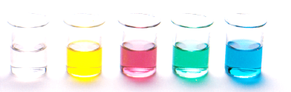
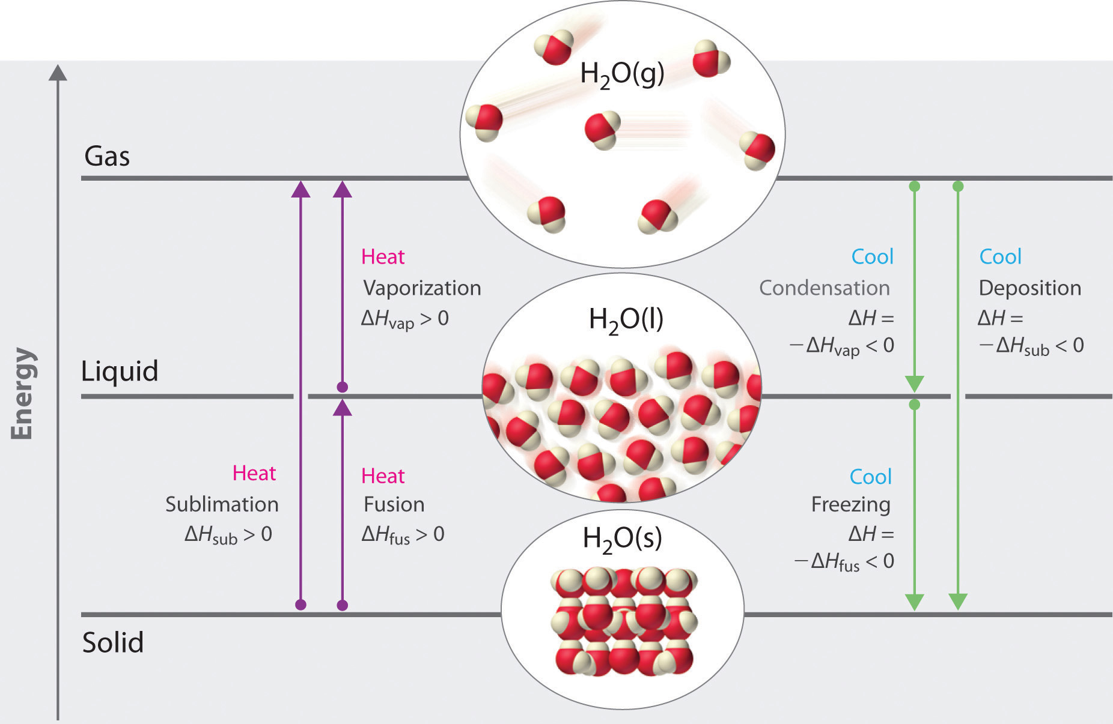
Intermolecular forces and physical properties
Review – the three types of intermolecular forces (IMF)
Change of phase – discussed in terms of intermolecular forces
Solubility
Vapour pressure

Slide 2
Review - IMF
Intermolecular forces (IMF)
The weak attractive forces between molecules
Three IMFs are:
Dipole-Dipole forces
Hydrogen bonding
Dispersion forces (sometime called London forces or van der Waals’ forces)

Slide 3
Review - IMF
Intermolecular forces (IMF)
Here is a video with a short explanation of each type of IMF (note in the video they refer to Dispersion forces as van der Waals’ forces)
FuseSchool – What are Intermolecular forces: https://www.youtube.com/watch?v=9YwdeEDrfPI

Slide 4
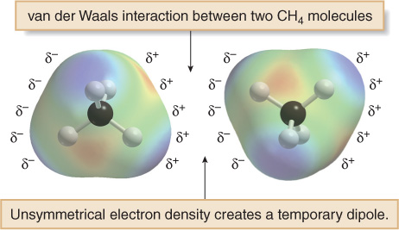
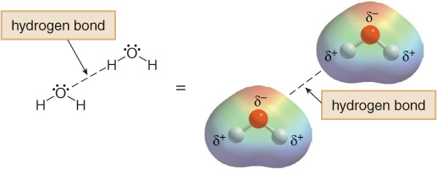
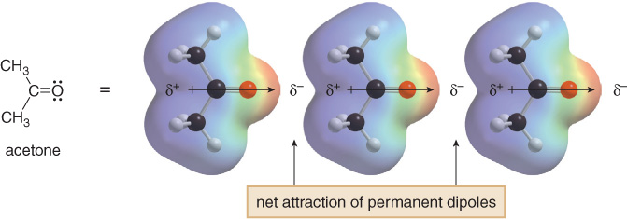

Slide 5
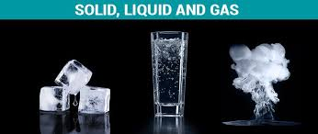
1. Changing phase

Slide 6
Changing phase
Changing phase refers to substances changing between a solid, liquid and gas
For a substance to melt or boil it needs to overcome some of the attractive forces between its molecules
This process requires energy, which the substance takes from the surrounding environment
The stronger the intermolecular forces present the more energy is required for the phase change to occur, so the higher the melting point or boiling point

Slide 7
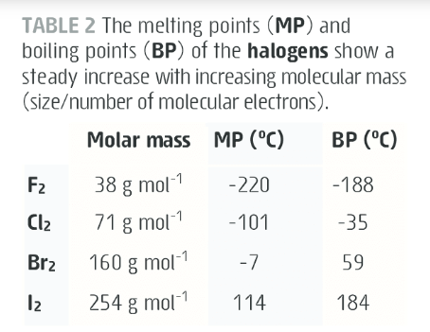
Changing phase
Consider the MP and BP trend down the halogen group
As we go done the molar mass increases as does the MP and BP. Lets explain this in terms of intermolecular forces.
Increasing molar mass means a molecule has more electrons. The more electrons a molecule has the more temporary or induced dipoles can form so the stronger the dispersion forces

Slide 8
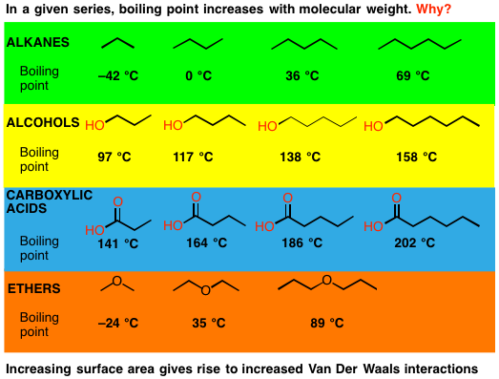
Changing phase
In a given series – increase molar mass (increase surface area, increase number of electrons) we see an increase in the BP due to increasing dispersion forces
E.g. ethane has weaker dispersion interactions than hexane so less energy is required to overcome the attractive forces between its molecules, so it has a lower BP

Slide 9
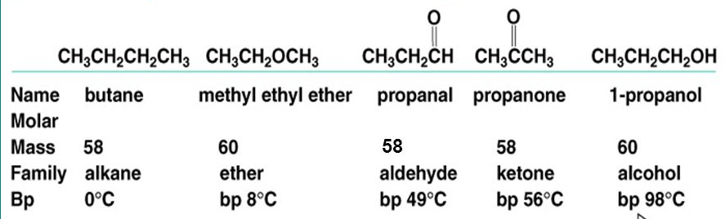
Changing phase
We can use boiling and melting points as an indicator of the relative strength of the intermolecular forces present in a substance with similar molar masses too
Use your knowledge of intermolecular forces to explain the boiling point trend in this series of compounds:

Slide 10
Changing phase
Molar masses are all comparable so the change in boiling point must be due to the presence of different types of intermolecular forces
Dispersion dipole-dipole
Dispersion only
Dispersion dipole-dipole
Dispersion hydrogen bonds
Added observation: ketone and aldehyde have similar bp so their dipole-dipole interactions must have similar strengths. But Ether has a much low bp suggesting its dipole-dipole interactions are weaker.

Slide 11
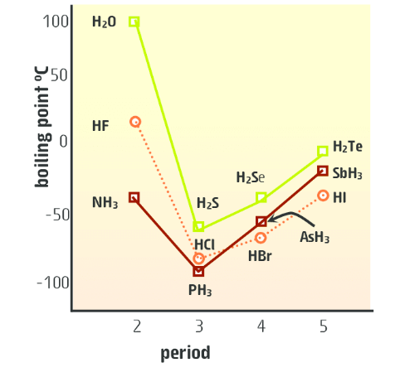
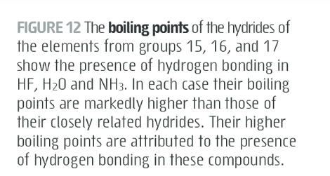
Changing phase

Slide 12
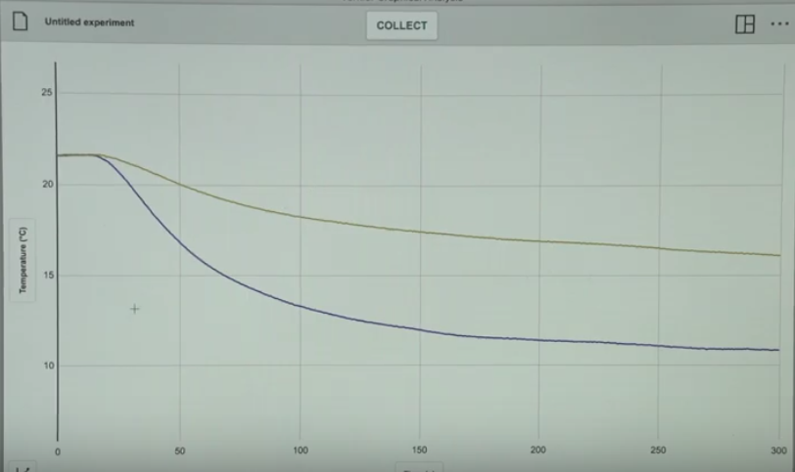
Virtual Expt – cooling effect
STAWA Experiment 15 looked at the cooling effect in the evaporation of methanol, ethanol, 1-propanol and 1-butanol.
https://www.youtube.com/watch?v=QiiMaO89AiE
Green – 1-propanol
Blue – ethanol

Slide 13
Virtual Expt – cooling effect
Two things to consider –
Rate of cooling – look at the slope near the start of the graph, the ethanol has a larger gradient therefore a faster cooling which means faster evaporation. Now link to IMF – ethanol have weaker IMF than propanol as it has less dispersion interactions due to having less electrons and lower surface area, so it requires less energy to separate the molecules, so it evaporates quickly.

Slide 14
Virtual Expt – cooling effect
Two things to consider –
Degree of cooling – hotter particles near the surface of the liquid ‘break free’ from the liquid and escape as a gas carry their higher kinetic energy with them. This decreases the average kinetic energy of the remaining liquid, which means the liquid or surface cools down. Ethanol has weaker IMF, more molecules have sufficient energy to ‘escape’ so the change in temperature (therefore, the cooling effect) is greater.

Slide 15
Virtual Expt – cooling effect
Green – 1-propanol
Blue – ethanol
Prediction – the location and shape of the graph for
1-butanol.
How does it compare to the video? A good lesson about being careful about what sources you rely on.

Slide 16
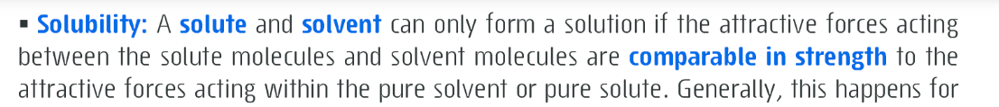
2. Solubility
For a solute and solvent to mix, forming a solution:
The forces of attraction between the molecules in solute must break
The forces of attraction between the molecules in solvent must break
New forces of attraction must form between molecules of solute and solvent
For this process to be energetically favourable the two substances need to have similar intermolecular forces present

Slide 17
Solubility
Generally, solutes and solvent mix to form a solution when they both contain similar intermolecular forces
This leads to the general chemistry rule of thumb – Like dissolves like
Example: petrol (a mixture of C₅-C₁₁ hydrocarbons) dissolves in kerosene (a mixture of C₁₀-C₁₅ hydrocarbons). Both substances are non-polar, with only dispersion forces present (also a similar size which also contributes to strength of the IMF present)

Slide 18
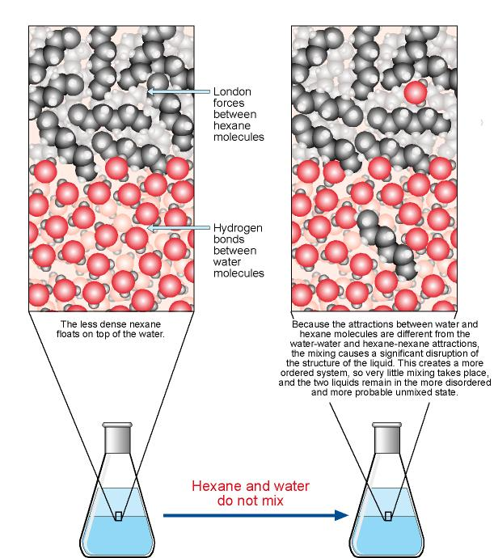
Solubility
Insoluble – compounds that do not mix to form a homogeneous mixture
Example: hexane and water
Identify the forces involved.
Explain in terms of attraction and energy of the system why the compounds do not mix

Slide 19
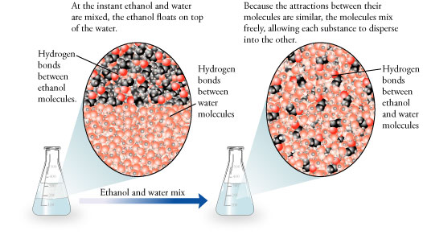
Solubility
Soluble – compounds that do mix to form a homogeneous mixture
Example: ethanol and water
Identify the forces involved.
Explain in terms of attraction and energy of the system why the compounds do not mix

Slide 20
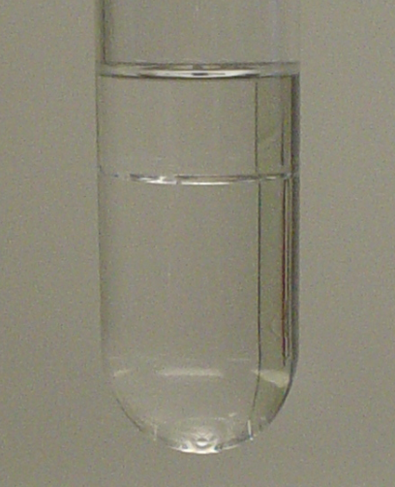
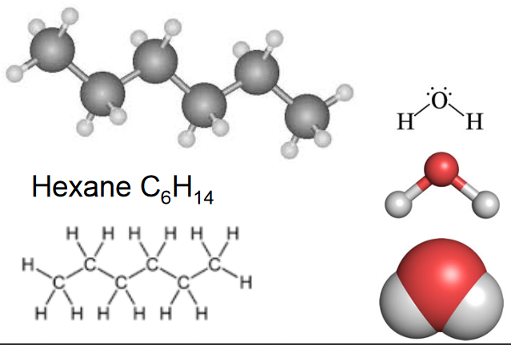
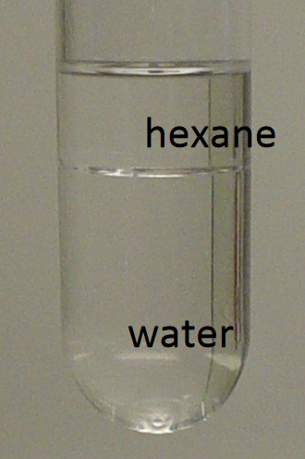
Solubility - practice
water + hexane

Slide 21
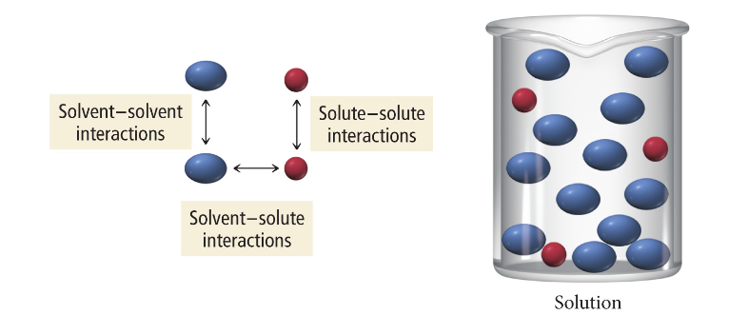
Solubility - practice
Hexane: non-polar, dispersion forces only
Water: polar, hydrogen bonding and
dispersion
Interactions between hexane and water are very weak compared to the interactions between pure hexane molecules and pure water molecules. Therefore, the two substances do not mix ie. Water is insoluble in hexane (and vice versa)

Slide 22
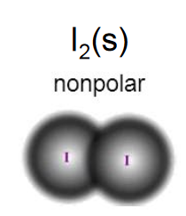
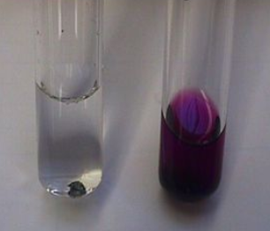
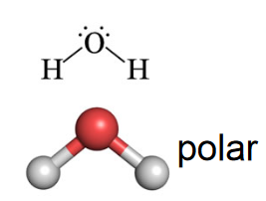
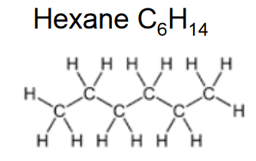
Solubility - practice
Iodine
water
hexane
insoluble
soluble

Slide 23
Solubility
Solubility video as revision - https://www.youtube.com/watch?v=PncGfNmalKQ

Slide 24
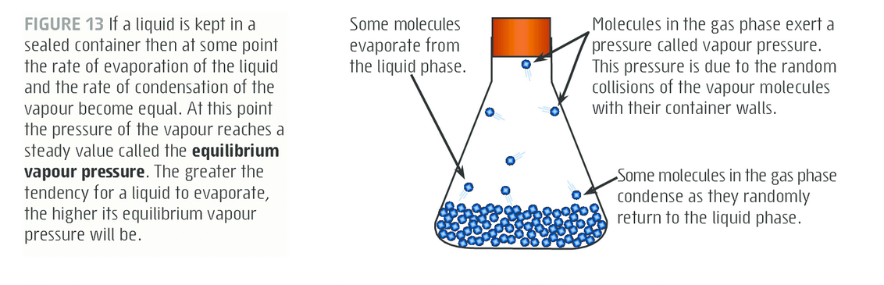
3. Equilibrium vapour Pressure

Slide 25
Equilibrium vapour Pressure
Vapour pressure is tendency of a substance to evaporate and is measured in kPa
To evaporate molecules must overcome the intermolecular forces of attraction keeping it in the liquid phase
Molecules with weaker IMF will have a higher vapour pressure

Slide 26
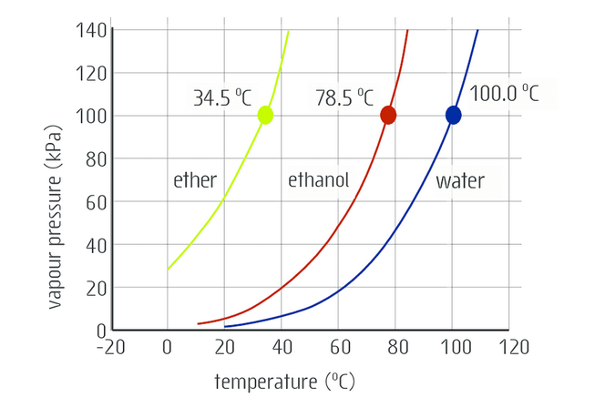
Equilibrium vapour Pressure
If you increase the temperature you will increase the vapour pressure (at higher temperatures molecules have higher average molecular kinetic energy, so the molecules are more able to escape their intermolecular forces of attraction)

Slide 27
Equilibrium vapour Pressure
At 20 °C what is the vapour pressure of ether, ethanol and water?
Ether 60 kPa, ethanol 5 kPa, water 1 kPa
Weaker the IMF the higher the vapour pressure. So graph allows us to rank the compounds according to the strength of the IMF present
(weaker) ether < ethanol < water (stronger)

Slide 28
Equilibrium vapour Pressure
A nice summary if you want to run through vapour pressure and intermolecular forces again at home
https://www.youtube.com/watch?v=iZqsQhZ1CAs

Slide 29
On going work
Complete all sections and chapter reviews for Intermolecular forces and Chromatography
Make sure you have completed the Chromatography summary note sheet – the students presentation can be found in the Collaboration section of Onenote and there are my Paper and TLC, and HPLC presentations in the content section of Onenote.

